Slide 1
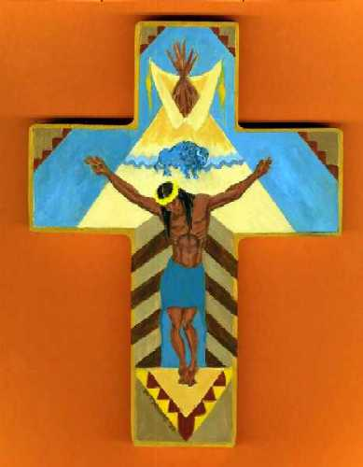

Deconstructing Savage Violence
The White Man’s Savage Genocide in Canada
By Susan G . Enberg
Notes:
Song: Gratitude to the Ancestors; painting by an indigenous artist: depiction of indigenous crucifixion by the White Man. http://glennsimmons.wordpress.com/2010/07/
READ PASSAGE BY WARD CHURCHILL, A Little Matter of Genocide (p. 1) “During the four centuries spanning the time between 1492, when Christopher Columbus first set foot on the ‘New World’ of a Caribbean beach, and 1892, when the U.S. Census Bureau concluded that there were fewer than a quarter-million indigenous people surviving within a country’s claimed boundaries, a hemispheric population estimated to have been as great as 125 million was reduced by over 90 percent.”
“The people had died in their millions of being hacked apart with axes and swords, burned alive and trampled under horses, hunted as game and fed to dogs, shot, beaten, stabbed, scalped for bounty, hanged on meat hooks and thrown over the sides of ships at sea, worked to death as slave laborers, intentionally starved and frozen to death during a multitude of forced matches and internments, and, in an unknown number of instances, deliberately infected with epidemic diseases.” (p. 1)
----- Meeting Notes (14-01-07 22:15) -----
1) “During the four centuries spanning the time between 1492, when Christopher Columbus first set foot on the ‘New World’ of a Caribbean beach, and 1892, when the U.S. Census Bureau concluded that there were fewer than a quarter-million indigenous people surviving within a country’s claimed boundaries, a hemispheric population estimated to have been as great as 125 million was reduced by over 90 percent.”
“The people had died in their millions of being hacked apart with axes and swords, burned alive and trampled under horses, hunted as game and fed to dogs, shot, beaten, stabbed, scalped for bounty, hanged on meat hooks and thrown over the sides of ships at sea, worked to death as slave laborers, intentionally starved and frozen to death during a multitude of forced matches and internments, and, in an unknown number of instances, deliberately infected with epidemic diseases.” (p. 1)

Slide 2
Complicity in Genocide
ARGUMENT: The Canadian government, members of the church, police institutions, and the media are all guilty of racialized demonization of Canada’s indigenous population
Each in its own deliberate way has supported fabricated notions of the ‘Savage Indian’ with genocidal intentions, in what Canada’s Truth and Reconciliation Commission calls the unending “colonial framework.”

Slide 3
Convention on the Prevention and Punishment of the Crime of Genocide,
Article 2
Adopted by Resolution 260 (III) A of the United Nations General Assembly on 9 December 1948. Canada became a signatory to the Convention in Nov. 1949.
Article 2
In the present Convention, genocide means any of the following acts committed with intent to destroy, in whole or in part, a national, ethnical, racial or religious group, as such:
(a) Killing members of the group;
(b) Causing serious bodily or mental harm to members of the group
(c) Deliberately inflicting on the group conditions of life calculated to bring about its physical destruction in whole or in part;
(d) Imposing measures intended to prevent births within the group;
(e) Forcibly transferring children of the group to another group.
Notes:
Convention of the Prevention and Punishment of the Crime of Genocide. http://treaties.un.org/pages/ViewDetails.aspx?src=TREATY&mtdsg_no=IV-1&chapter=4&lang=en Accessed 12 November 2013.
----- Meeting Notes (14-01-07 22:15) -----
BUT there is a problem in applying the Genocide Convention in places like Canada and the United States. Considering that those who decide whether or not genocide indeed occurred in these countries are the progeny of the colonizers themselves, there cannot be a fully objective body to make such decisions. Those who made the decide to implement the Genocide Convention did not intend for it to be applied to their own countries. Also, no international law conventions that I know of can be considered retroactive. Canada became a signatory to this particular convention in 1949, and the United States in 1948. In fact, the Convention itself clearly states that it may not be applied to any such crimes prior to Jan. 12/1951 (date of enforcement of the Convention). Also, being a signatory to the Convention is IRRELEVANT unless a country ratifies the Convention. Canada did not ratify the Convention until 1952, and the United States did not ratify the agreement until 1988. As the U.S. is the biggest contributor to the United Nations, and has the most political clout, it is highly unlikely that the U.S. will ever be charged with crimes of genocide DESPITE any evidence provided by less powerful countries. Being in bed with the U.S. both ideologically and politically, it is unlikely that the Canadian government will ever admit to, or be charged with crimes of genocide.

Slide 4
Non-lethal Eliminationism:
Cultural Genocide
Goldhagen states:
“Sometimes an eliminationist onslaught is, or includes, non-murderous, transformative cultural (and social) initiative, such as when perpetrators compel victims to convert or renounce their religion…The perpetrators know that destroying the victims’ cultural institutions, objects, and artifacts, further undermines them.” (p. 141)

Slide 5
5 Means of Eliminationism
(acc0rding to Daniel Jonah Goldhagen)
Transformation
Repression
Expulsion (OR I would include containment)
Prevention of reproduction
Extermination (physical, psychological, and cultural)
Notes:
Worse Than War: Genocide, Eliminationism and the Ongoing Assault on Humanity by Daniel Jonah Goldhagen

Slide 6
“Nits Make Lice” by Ward Churchill
(in A Little Matter of Genocide)
Churchill makes clear that up until the 1980s, scholars and academic institutions DELIBERATELY underestimated AND falsified the number of indigenous peoples in the hemisphere to hide crimes of genocide. Even now, politicians in North America continue to deny genocide.
The phrase “nits make lice” was spoken by a pastor turned general. What he meant is that even the smallest ‘Indians’ should be killed to ensure decimation of the indigenous population…that no matter how young, they should be murdered.

Slide 7
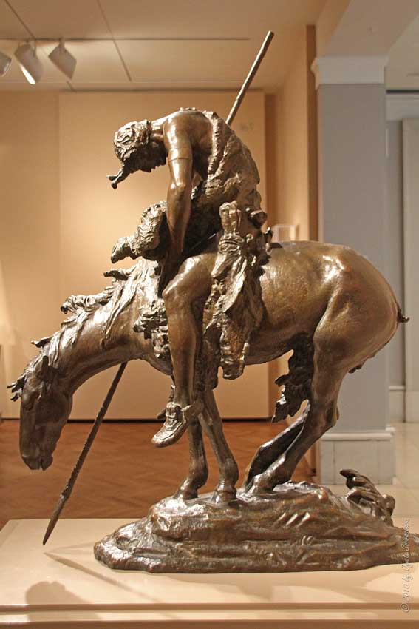
End of the Trail Sculpture (1915) by James Earl Fraser
Found at the Cowboy and National Heritage Museum in Oklahoma City. The artist struggled with which image of the Native American would be the most appropriate to depict--a vanishing race of savage warriors or the transformation of proud, spiritual people into the next century.
Notes:
Information on End of the Trail Sculptures: http://www.nationalcowboymuseum.org/education/lesson-plans/Fraser/Fraser.aspx
The End of the Trail James Earle Fraser (1876-1953) Plaster (approximately 17' x 14' x 5') National Cowboy & Western Heritage Museum, Oklahoma City

Slide 8
Treaties – A False Flag
A FALSE FLAG Canada’s government signed treaties with many First Nations people to avoid an expensive ‘Indian’ war. BUT the government has continually undermined these treaties so that it can have full control of all lands in Canada. One way this has been done is with the construction of ‘Indian Savages’ to justify murder and abuse − absolute and cultural − of Canada’s First Citizens.
The media has been instrumental and complicit in the fabrication of the ‘Indian Savage’ for politically motivated murderous ends. Greed continues to dominate abuse and neglect of Canada’s indigenous population by the Canadian government, the media, and other imperialist institutions.
Notes:
“Although colonization took many forms, the seizure of Native land was the
cornerstone of conquest and white settlement.” and “Racism was
not only about keeping whites up and the lower orders down. Instead, it was also about
placing whites and comrnunities of color in their ‘proper" spaces.’” The 'Savage Indian' and the 'Foreign Piague ': Mapping Racial Categories and
Legal Geographies of Race in British Columbia, 18 71-1925,” dissertation by Renisa Mawani (U of T Department of Criminology), 2001: 3-4.

Slide 9
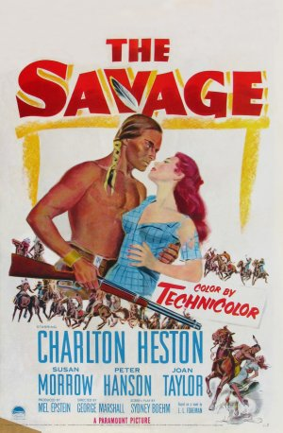
Demonological Racism
(Itwaru, “Master Race, Murder and Gory Globalization”pg. 58)
Demonological racism…feeds off the euro-centric belief in the demonology of evil, the fear of demonic forces which must be conquered by the forces of light and rightness − which…the White liberal democracies of the West righteously think they are. The belief in primal demonic threats breeds a terrifying fear which will only be ameliorated by the destruction of those who are PERCEIVED as the threatening demonic hordes.
Notes:
This presentation will show however, that the demons are not real; these so-called ‘demons’ are instead political and social constructs enabled when deemed necessary by the White Man to gain consensus for abuse and mass murder. In the case of Canada’s indigenous population, these demonic constructs were enabled by politicians, the media, and religious institutions in their attempts to commit cultural and physical genocide. To justify abuse and mass murder of Canada’s indigenous population each of these institutions constructed Canada’s indigenous peoples − including indigenous children − as ‘savages’ that deserved to be killed, and if not killed then ‘civilized.’ Today even, Canada’s indigenous people are portrayed as an unwanted society, troublesome in light of the fact that they continue to resist governmental attempts at colonization.

Slide 10
The Demonized Other
“There is no concern for the people who are murdered…These are the demonized Other, the Enemy. Their deaths , their mourning, their loss does not matter. Those who have committed these murderous deeds demonstrate no remorse …and they will repeat this anti-human anti-life behavior and continue to feel good about it.”
Arnold Itwaru, “Master Race, Murder and Gory Globalization,” p. 40.
Notes:
READ from TRC doc, “They Came for the Children (2012): p. 3…Canada’s indigenous peoples were their own civilizations…civilizations that were disavowed as such by British colonizers to justify their genocidal actions. Here is a quote from “They Came for the Children”: “The destruction and transformation of Aboriginal societies , which was unleashed in the name of civilization, did not constitute progress for the people who lived in those societies. They already had an effective understanding of environment. They had developed practices and technologies to draw a long-term livelihood from it efficiently. They each had a set of spiritual beliefs that provided coherence in their lives. They had social structures based on well-developed principles and values. Their societies were not without violence and social problems, but neither were the societies that sought to civilize them. The process of ‘civilizing’ was, in reality, the process of destroying a continent FULL OF CIVILIZATIONS.” As Professor Itwaru makes clear in this article, not a lot has changed with respect to this euro-supremacist mentality. White Western society continues to justify mass-murder through armed interventions by declaring racialized peoples to be the demonized Others, the Enemies.

Slide 11
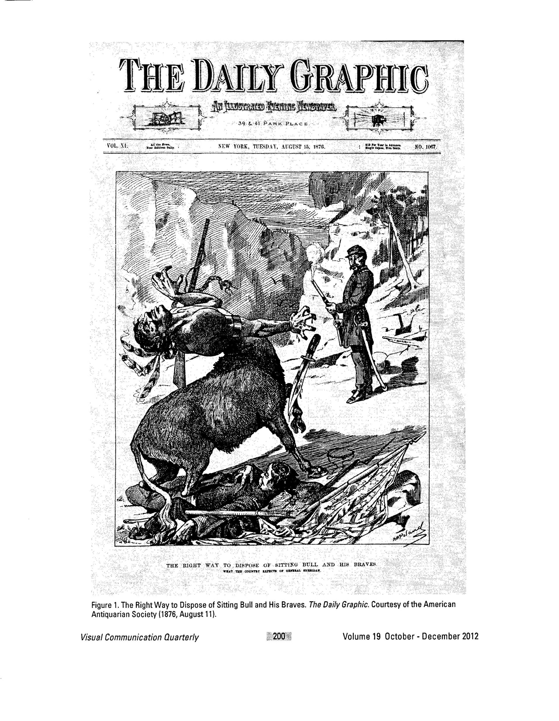
Notes:
In John M. Coward’s article, “Making Sense of Savagery: Native American Cartoons in The Daily Graphic,” he states that “the cartoon titled “The Right Way to Dispose of Sitting Bull and His Braves” was a response to the Sioux and Cheyenne victory over George Custer’s Seventh Cavalry in Montana…It depicted a half-buck creature who – having killed and scalped a U.S. soldier – has just been gunned down by another soldier.” The illustration is a political statement, aligned with white societies grievances, and depicts the indigenous warrior as a hideous and grotesque monster, while on the other hand it depicts the slain soldier as a noble white man killed by the savage ‘Indian’. The depiction of the indigenous warrior as a savage being served the purpose of Othering, of racial demonization, and constructing the enemy.

Slide 12
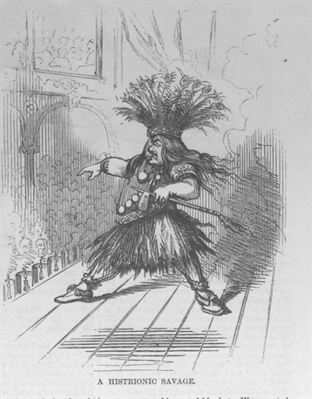
Sitting Bull as a ‘Savage’

Slide 13
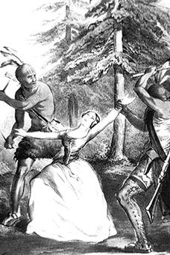
The Murderous Mode of Reasoning
“In the murderous mode of reasoning…racialized Others are not considered human. They are reduced into the dangerous threatening Enemy-Other who must be killed.”
Itwaru, “The Murderous Mode of Reasoning and the Murderous Patriot-Subject,” p. 26
Notes:
In the case of Canada’s indigenous population, the media consciously fabricated articles on savage Indians and how Indian men were intent on claiming white women and raping them brutally. This became an especially prominent and effective practice of the media, spurred on by the Canadian government, in the late 19th century, after Confederation. In times before photographic accuracy, the artist’s imagination and sensationalism served to fire racial hatred and human rights abuses. Photo Source: http://twain.lib.virginia.edu/projects/rissetto/bad.jpg
An 1846 Currier and Ives print depicting the murder of Jane McCrea

Slide 14
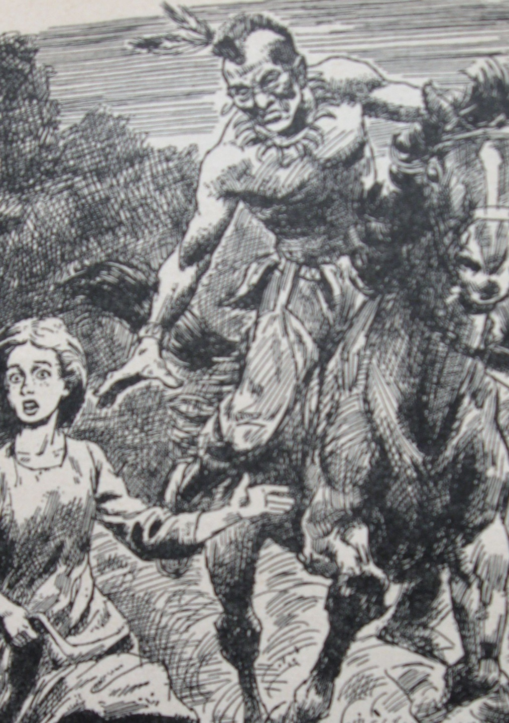
Fear in the Forest, 1960
Illustration from a 1960 book titled Fear in the Forest written by Cateau de Leeuw, illustrated by Leonard Vogsburgh.
The first sentence of the Foreword: “There was only one way to make Ohio territory safe for the settlers and that was to defeat the Indians.”
In the next line appears the phrase “the savage foe.”
Notes:
http://kathyewing.com/wp-content/uploads/2010/08/Copy-of-IMG_0303.jpg Illustration from a 1960 book titled Fear in the Forest written by Cateau de Leeuw, the illustrator is Leonard Vogsburgh. The first sentence of the Foreword: “There was only one way to make Ohio territorysafe for the settlers and that was to defeat the Indians.”
In the next line appears the phrase “the savage foe.

Slide 15
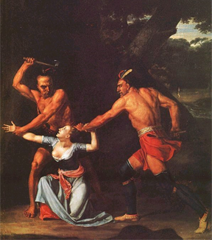
Stereotyping the ‘Savage’ Indian
A Most Poignant Quote:
“History has shown that stereotyping can lead to scapegoating, which can lead to discrimination, which can lead to segregation, which can lead to physical abuse, which can lead to state-sponsored genocide.”
Source: Images that Injure: Pictorial Stereotypes in the Media, editors Paul Martin Lester and Susan Dente Ross, p.2.
Notes:
http://static.tvtropes.org/pmwiki/pub/images/Savage_3_450.png This is precisely what has unfolded in Canada with the impetus coming from the Canadian government, colonial institutions, and churches. The tragedy is that White people both constructed and bought into these lies and their complicity makes them mass murderers.

Slide 16
Royal Bagot Commission, 1844
Established to examine the topic of aboriginal education in Canada
Recommendation: to train native students in as many manual labour or industrial schools as possible;
Isolated from the influence of their parents pupils would imperceptibly acquire the manners, habits and customs of civilized life.
Notes:
Zia Akhtar, “Canadian Genocide and Official Culpability” (International Criminal Law Review, 2010): 113

Slide 17
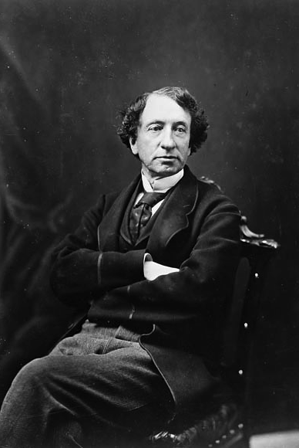
John A. McDonald, Prime Minister of Canada, 1878-1891: His view on the education of ‘Indian’ children
“In 1883, he told the House of Commons, ‘When the school is on the reserve, the child lives with his parents who are savages, and though he may learn to read and write, his habits and training and mode of thought are Indian. He is simply a savage who can read and write.”
Source: “ They Came for the Children: Canada, Aboriginal Peoples, and Residential Schools” (Truth and Reconciliation Commission, Government of Canada, 2012): p. 6.
Photo Source: http://upload.wikimedia.org/wikipedia/commons/3/37/Macdonald1872.jpg
Notes:
In 1883, Hector Langevin, the Public Works Minister of Canada, stated, “In order to educate the children properly we must separate them from their families. Some people may say this is hard but if we want to civilize them, we must do that.” Citation: “They Came for the Children: Canada, Aboriginal Peoples, and Residential Schools” (Truth and Reconciliation Commission, Government of Canada, 2012): p. i. Residential schools for Canada’s indigenous population were ‘preferred’ as in day schools, the children could still return home to the ‘savage examples’ of their parents. “They Came for the Children” (TRC, Gov’t of Canada, 2012): p. 11.

Slide 18
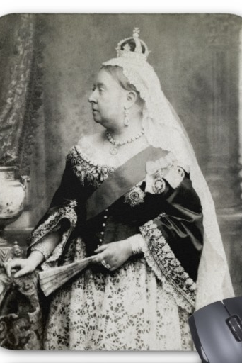
Queen Victoria’s Red Children
Government negotiator, Alexander Morris, stated :
“The Queen wishes her red children to learn the cunning of the white man and when they are ready for it she will send schoolmasters…”
Source: “They Came for the Children” (TRC, Canadian Government, 2012): p. 9.
Notes:
Photo Source: http://rlv.zcache.com/c_1880_queen_victoria_of_england_mouse_pads-r81fcfd9e58bb4c5eb1a9177b9448e70c_x74vk_8byvr_512.jpg

Slide 19
CRITICAL ISSUES Affecting Survivors of Residential Schools: Assimilate or Die
Dismemberment of family relations: children were removed without parental consent through strong-arm tactics of the Canadian government, police services, and churches
Inferiority-Superiority dichotomy: “Indians” need(ed) to become “white” in mind and manners to ensure effective assimilation and to quell potential dissent
Conscious destruction of cultural knowledge and ties to community
Immeasurable psychological, sexual, and physical abuse
Dehumanization of indigenous peoples by “white” society, most especially politicians, the media, churches and the medical and scientific communities with the complicity/apathy of the general population
Continuing dehumanization of indigenous persons to this day
Only LIMITED truths permitted by the Canadian government: no admittance of genocide
Notes:
Speak about movie, Experimental Eskimos.
----- Meeting Notes (14-01-08 12:36) -----
In the early 1960s the Canadian government conducted an experiment in social engineering. Three young Inuit boys were separated from their families in the Arctic and were sent to Ottawa, the nation's capital, to live with white families and to be educated in white schools. The consequences the experiment would have on the boys, their identity and culture was brushed aside. The bureaucrats did not anticipate the outcome. The three grow up to be political activists and leaders - often at odds with the government that brought them south. They establish aboriginal rights in Canada and are instrumental in the creation of Nunavut, the world's largest self-governed aboriginal territory. But it all comes at a tremendous personal cost.

Slide 20
The Birth of Indian Residential Schools
Prime Minister John A. McDonald commissioned Nicolas Flood Davin to write a report on Indian Industrial Schools:
  The report, “Industrial Schools for Indians and Half-Breeds” (1879) argued for a policy of “aggressive civilisation.”
      Indian Residential Schools were the means and the way to ensure this policy of “aggressive civilisation.”
      Schools have often referred to as ‘JAILS’ by survivors, for good reason
Notes:
Zia Akhtar, “Canadian Genocide and Official Culpability” (International Criminal Law Review, 2010): 114. Modeling for Indian Residential Schools was truly conceived in the 1870s, as Canada had already been sending children of the urban poor, children deemed “dangerous elements,” to residential schools known as reformatories. Thus, these reformatories and jails were the models to be used in the creation of Indian Residential Schools. “They Came for the Children” (TRC, Government of Canada, 2012): p. 13.

Slide 21
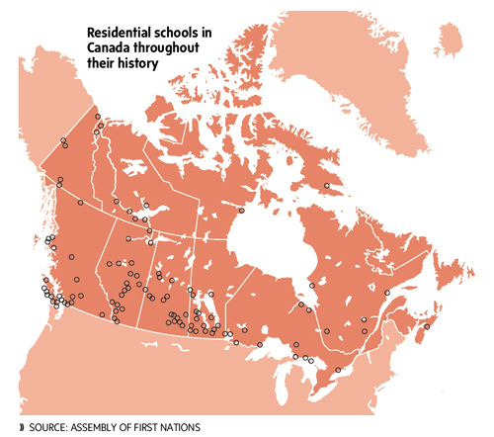
Notes:
MAP: http://www.manataka.org/images/Canada's%20Residential%20School%20map.jpg. There were at least 134 Indian Residential Schools that were federally funded. The last of these was closed in 1996. Many indigenous people in Canada belief that Indian Day Schools should be included in any considerations for compensation due to abuse. Thus, in reality, there are really 1300 or more schools that were attended by Canada’s indigenous population, all of which are potential sites of abuse. This figure is often omitted by the media in their complicity to ‘underplay’ the genocide of Canada’s First Citizens.

Slide 22
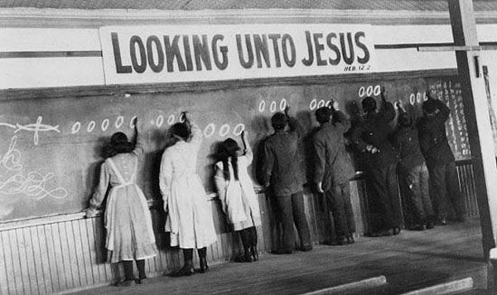
Legal Definition of ‘Indian’ (early 20th century)
“They were told their cultural beliefs were sinful.”
“An uncivilized person, destitute of knowledge of God or any fixed and clear belief in religion.”
Viewed as “immoral beings” by the United Church Schools, one principal, Alfred Caldwell stated:
  “At our school we strive to turn them into mature Christians who will learn how to behave in the world and surrender their barbaric way of life and their treaty rights which keep them trapped on their land and in a primitive existence.”
Source: http://thetyee.cachefly.net/Presents/2013/09/04/ResidentialSchoolJesus600px.jpg
Notes:
Zia Akhtar, “Canadian Genocide and Official Culpability” (International Criminal Law Review, 2010): 116.

Slide 23
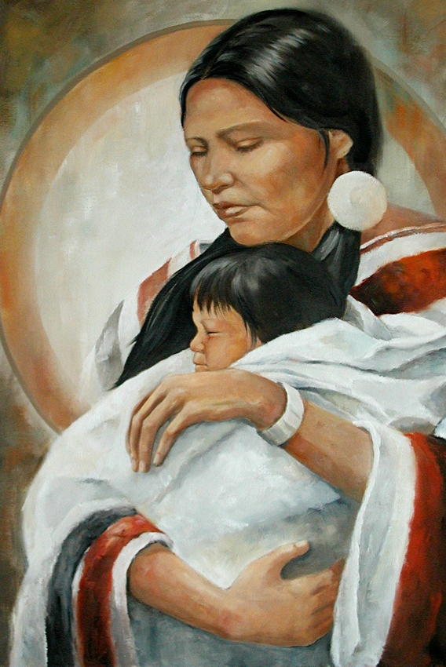
Civilizing the ‘Savage Indian’ Child
The government and churches upheld that Indian children must be removed from their homes at an early age to reduce the ‘savage’ and ‘uncivilized’ influences of family members. Otherwise the children would remain savages themselves.
Source: http://ostyn-newman.com/Beagle_Painting_21_files/motherstreasure.jpg

Slide 24
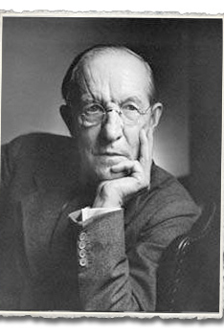
Duncan Campbell Scott, ‘Renowned’ Poet, Superintendent of Indian Affairs from 1913-1932
“I want to get rid of the Indian problem. Our object is to continue until there is not a single Indian in Canada that has not been absorbed.”
Photo: Yousuf Karsh Source: Library and Archives Canada, PA-165842
Notes:
Andrew Woolford, “Ontological Destruction: Genocide and Canadian Aboriginal Peoples” in Genocide Studies and Prevention, 4:1 (2009): 92. This statement fairly depicts the mood of much of Canada’s White elitist population of the day. White supremacist notions led to policies and practices of neglect, genocide, ethnocide, abuse, and murder.
----- Meeting Notes (14-01-08 12:45) -----
Children were targeted rather than spared. In 1913, Scott admitted that unfortunately, up to 50% of students registered at Indian Residential Schools were not to benefit from a proper education. Why? They had died at the schools from illnesses such as tuberculosis, influenza, smallpox and I think it is only right to include extreme neglect, abuse, despair and loneliness. During the Spanish flu epidemic of 1918-1919, indigenous children who died were often buried two-to-a-grave in order to save money. In some cases, parents were never informed that their children had died.

Slide 25
By 1908: IRSs Deemed a Failure
“By 1908, federal Indian Affairs minister Frank Oliver had concluded that ‘the attempt to elevate the Indian by separating the child from his parents and educating him as a white man has turned out to be a deplorable failure.’”
Despite this admission, churches and the government continued their ‘civilizing missions.’

Slide 26
“Perhaps it has even been assumed that once all Indian children are brought to school and are given a dose of the magic elixir of Canadian education all we and the sceptics have to do is sit back and wait for the older uneducated Indian adults to die off and the ‘Indian Problem’ will come to its timely end.”
(Mrs. Mary Anne LaVallee, First Nations Speaker at the National Conference on Indian and Northern Education Saskatoon (1967), p.26.

Slide 27
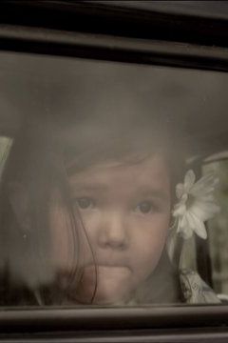
The Indian Act, 1876
Passage added in 1920 making it “mandatory for every Indian child to be sent to residential schools upon reaching seven years of age.” This made it legal for police, church or government authorities to “use whatever force necessary” to remove the children from their homes. Stolen children.
Notes:
Photo from film, “We Were Children”; Zia Akhtar, “Canadian Genocide and Official Culpability” (International Criminal Law Review, 2010): 116.

Slide 28
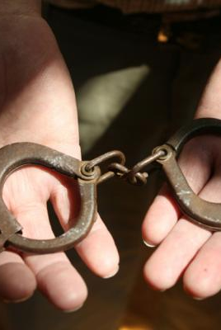
Tiny Handcuffs for “Indian” children
The purpose of these tiny handcuffs was to restrain indigenous children when they were being stolen from their homes to be forcibly assimilated at Indian Residential Schools. The objective of these schools was to ‘kill the Indian within the child.’
Notes:
http://indiancountrytodaymedianetwork.com/article/tiny-horrors-chilling-reminder-how-cruel-assimilation-was%E2%80%94and-146664 accessed 20 November 2013. Source: Indian Country website, “Tiny Horrors: A Chilling Reminder of How Cruel Assimilation Was,” 1 January 2013. Author Mary Annette Pember.

Slide 29
Civilizing ‘Savage Indian’ Children
When indigenous children entered Indian Residential Schools, they:
  Were immediately stripped of any native clothing
  Had their hair shorn, were violently scrubbed down
  Were not permitted to speak their own languages
  Were given ‘new’ Christian names AND were numbered
  Were not allowed to follow any native customs, or to speak of them
  Male and female siblings were segregated
  PUNISHMENT FOR ANY DISPLAY OF INDIGENEITY WAS OFTEN BRUTAL AND DEADLY (PHYSICALLY OR PSYCHOLOGICALLY)
  SOUNDS LIKE GENOCIDE
Notes:
For over 130 years till 1996, approximately 150,000 of Canada's First Nations children were legally required to attend government-funded schools run by various Christian faiths. By 1931, there were 80 of these 'residential schools' across the country. Most children were sent to faraway schools that separated them from their families and traditional lands. These children endured starvation, brutality, physical hardship, mental degradation, and the complete erasure of their culture. The schools were part of a wider program of assimilation designed to integrate the native population into 'Canadian society.' These schools were established with the express purpose 'To kill the Indian in the child.' Children, rather than being called by their ‘new’ Christianized names were called by their numbers, e.g. – 39, sit down right now…44, recite the Lord’s Prayer in English. The raping of indigenous identity is clear, and must be considered deliberate efforts at cultural genocide.

Slide 30
The Lactification of Consciousness and the Epidermalization of Inferiority
Fanon in Black Skin, White Masks, upheld that:
The lactification of consciousness refers to embedded beliefs of the enslaved, beliefs that have been beaten into a colonized (peoples) with the objective of ensuring that they will never forget their place in a hierarchal and pluralized society based on socially constructed racial differences.
The epidermalization of inferiority is the internalization of the belief of what the colonizer has espoused for centuries: that the racialized other (e.g. African, indigenous societies) is inferior to the European and the Westerner precisely because of her skin color.
Notes:
----- Meeting Notes (14-01-08 12:45) -----
Aldous Huxley in his book, Brave New World, written and first published in refers to this 'lactification of consciousness' later expanded upon by Fanon. With regard to the people imprisoned within the Savage Reservations of Malpais (which means sick state), there is a passage that resonates with the treatment of the indigenous population in Canada, and the Americas as a whole. The passage reads: "And remember...they're perfectly tame (the indigenous population); savages won't do you any harm. They've got enough experience of gas bombs to know that they mustn't play any tricks." (p. 95)

Slide 31
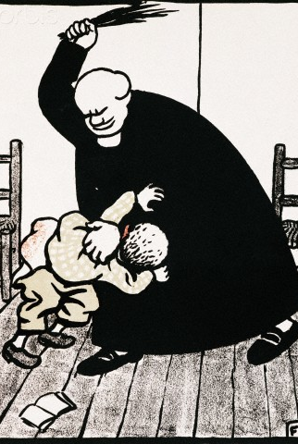
CIVILIZING PUNISHMENTS FOR DISPLAYS OF ‘SAVAGE’ INDIGENEITY
INCLUDED (but not limited to):
Brutal beatings
Sexual assault/rape/sodomy
Starvation, malnutrition*
Needles pierced through tongues for speaking native languages
Forced literally to hold tongues for hours if unable to speak English, or if having spoken a native language (hence the term ‘hold your tongue’)
Forced to kneel for many hours, at times all night, on hard floors
Solitary confinement for extended periods of time*
Murder
http://www.corbisimages.com/images/Corbis-DS002262.jpg?size=67&uid=2819879c-9364-40ef-a742-c029f31e8c31
Notes:
Phil Fontaine, the National Chief of the Assembly of First Nations, often refused to eat the slimy porridge or other horrible food served to him. His punishment was that his dinner was thrown on the floor; he was then forced to eat the food on the floor. For Fontaine, “eating became a real psychological terror.” On the sly, some of the children would hunt gophers or rabbits to roast over an open fire; others would steal and eat frozen meat or fruits when the nuns and priests weren’t looking. Source: “They Came for the Children” (TRC, Government of Canada, 2012): 32 -33. While the children were starving, staff at the schools were often ‘feasting’ on steaks or roast chicken. (TRC, 2012): 34. However, when outside inspectors came to visit, the children were served real food like bacon and eggs and toast with butter. (TRC, 2012): 34. “In 1914 a court in Brantford fined the principal of the Mohawk Institute $400 for confining two runaway girls to a cell for two days, and whipping one of them.” On the other hand, another principal was exonerated for flogging 19 students following a theft at one of the schools; months later the boys still bore the painful marks of a seven-thronged strap made from leather.(TRC, 2012): 38. Students who ‘misbehaved’ were often put into small cells or ‘punishment’ rooms and fed only bread and water.”In 1896 an Indian agent said the behaviour of a teacher at the Red Deer school ‘would not be tolerated in a white school for a single day in any part of Canada.” (TRC, 2012): 38.

Slide 32
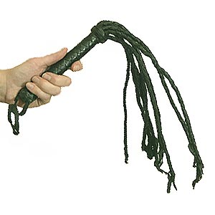
Whipped into Submission
One tool of ‘civilisation’

Slide 33
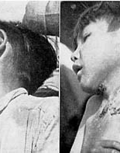
Duncan Campbell Scott, Guilty of Attempts at Genocide
Duncan Campbell Scott is famous for his policy designed to “kill the Indian within the Indian.” If the children didn’t die of disease or abuse, then cultural genocide would assist this in happening.
Photo: http://journeytoforever.org/farm_library/price/Fig.16.jpg; Indigenous children continued to die from tuberculosis due to lack of funding/treatment.
Notes:
Zia Akhtar, “Canadian Genocide and Official Culpability” (International Criminal Law Review, 2010): 115-116. http://www.nlm.nih.gov/exhibition/if_you_knew/ifyouknew_07.html cites that "As stated previously adults and children are housed in the same quarters; only the more violent cases are segregated in single rooms. Cases of tuberculosis were reported in the hospital building, but no precautions were being taken to protect the other patients from them, nor were their dishes sterilized.” According to Canada’s Truth and Reconciliation Report of 2012, tuberculosis was let to run rampant at Indian Residential Schools and ‘new’ students weren’t screened for communicable diseases. Tuberculosis was only taken seriously once the ‘general (white) population’ became threatened.

Slide 34
http://www.youtube.com/watch?v=AUr3ShsQQvg
Notes:
READ PASSAGE THEN PLAY YOUTUBE SHORT. P.H. Bryce, The Story of a National Crime: An Appeal for Justice to the Indians of Canada (Ottawa: James Hope and Sons Ltd., 1922); Zia Akhtar, “Canadian Genocide and Official Culpability” (International Criminal Law Review, 2010): 115. The Story of a National Crime was published in 1922 after Dr. P.H. Bryce was terminated as the Chief Medical Officer for Indian Affairs. His crime was bringing attention to the neglect of indigenous children at residential schools in Canada since 1909. No one in the government listened, most especially Duncan Campbell Scott. Although he had informed the Canadian federal government numerous times that untold numbers of children were dying from tuberculosis, he was ignored. Contagious children were forced to spend time close to healthy children so that both might become ill, and possibly die.
Sounds like genocide.

Slide 35
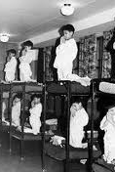
Intentional Underfunding Ensured that Tuberculosis Would Run Rampant among Indigenous Populations
Out of 175 indigenous children surveyed (1922, Qu’appelle Saskatchewan), 93% were infected with tuberculosis
At Indian Residential Schools, children with TB were forced to remain in contact with healthy children
Only $10,000 was allocated to combat TB at 105 reservations, less than 1/3 of that provided to Ottawa (1919)
Government acutely aware that TB was causing a decline in the indigenous population; their response was inaction
If we allow for natural population increases, the Blackfeet population was reduced by 40% due to non-treatment and non-containment of persons infected with tuberculosis
Dr. Bryce calls this “Criminal disregard for the treaty pledges to guard the welfare of the Indian wards of the nation.”
Notes:
Dr. P.H. Bryce, The Story of a National Crime: An Appeal for Justice to the Indians of Canada. READ: In 1908, Samuel Blake, an activist of the Anglican Church, “argued that the health conditions in the…schools were so dire that the government was leaving itself open to charges of manslaughter.” Source: “They Came for the Children” (TRC, Gov’t of Canada, 2012): 17.

Slide 36
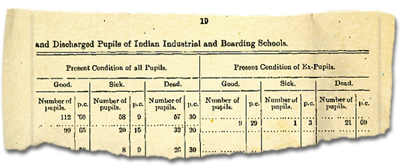
Source: http://www.wherearethechildren.ca/images/blackboard/bryce-report.jpg

Slide 37
Health Signifiers of Total Neglect (1940s)
Tuberculosis death rate of 1,400 per 100,000 among the aboriginal population (Cree) of Manitoba
Compare this to 27.1 deaths per 100,000 for the non-aboriginal population of Manitoba
Cree of Manitoba had an infant mortality rate 8 times higher than the rest of Canada
Crude mortality rate 5 times higher than Manitoba as a whole
Notes:
Ian Mosby, “Administering Colonial Science: Nutrition Research and Human Biomedical Experimentation in Aboriginal Communities and Residential Schools” in Social History, Vol. XLVI, no. 91 (May 2013).

Slide 38
Aboriginal Children as the White Man’s Lab Rats
As wards of church and state, neither the children of residential schools nor their parents were asked for informed consent with regard to medical experimentation
  Moore wrote (1941) that because “the Indian” often has the “psychology of a child,” researchers should avoid alarming him “by speaking within his hearing of procedures he does not understand.”
Trials were performed on children at residential schools. The most ambitious of these was performed in the James Bay region by University of Toronto anthropologist, G. Gordon Brown.
Aboriginal peoples were classified by the biomedical community of Canada as “experimental materials”; residential schools and communities considered the White Man’s “laboratories”
Malnutrition of indigenous communities seen as a tragedy and as an unparalleled research opportunity for testing nutritional supplements of which researchers had no idea about correct dosages
Notes:
Ian Mosby, “Administering Colonial Science: Nutrition Research and Human Biomedical Experimentation in Aboriginal Communities and Residential Schools” in Social History, Vol. XLVI, no. 91 (May 2013).
----- Meeting Notes (14-01-07 23:35) -----
Maureen Lux, in her article "Perfect Subjects: Race, Tuberculosis, and the Qu'Appelle BCG Vaccine Trial," makes perfectly clear that the first experimental TB vaccines were tried and tested on Canada's indigenous population. White society 'blamed the victim' for their plight, their 'lot in life,' and thought nothing of using Canada's indigenous population as 'lab rats' prior to using the vaccination on members of white society.

Slide 39
Starving Aboriginal Children Used as the White Man’s Lab Rats
The Canadian government deliberately underfunded Indian Residential Schools, ensuring slow and deliberate starvation of the children*
Parents of children at residential schools had been telling the government for decades that their children were starving BUT it was not until the mid-1940s that something was done
While some residential schools were provided nutritional supplements (experimental) for the children, other control groups received nothing and continued to suffer intensive malnutrition; these groups were also denied dental care
Notes:
Ian Mosby, “Administering Colonial Science: Nutrition Research and Human Biomedical Experimentation in Aboriginal Communities and Residential Schools” in Social History, Vol. XLVI, no. 91 (May 2013). , Foods that were served were often rotting….rotting meat, rotting vegetables. Many children became ill from being force to eat these rotten foods. One boy ran away from school in 1902 because the food was so horrible…he froze to death. Although the government knew since 1897 that the food was ‘horrible’, little changed over the years. Children continued to steal, hunt, and dig through garbage cans just to fill their tummies. (TRC, 2012): 34.

Slide 40
Sexual Sterilization of Children at Residential Schools
Alberta: Sexual Sterilization Act of 1928, “allowed that any inmate of a native residential school to be sterilized upon approval of the school principal.”
British Columbia: Implementation of the Sexual Sterilization Act of 1933 (only overturned in 1972), identical terms to Alberta’s Sexual Sterilization Act.
Notes:
Zia Akhtar, “Canadian Genocide and Official Culpability” (International Criminal Law Review, 2010): 117.

Slide 41
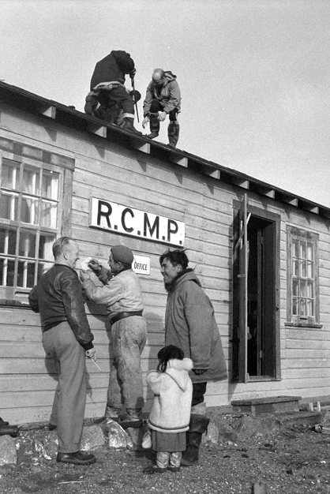
The ‘Eskimo Problem’ and Social Engineering
“The 1950s saw the Department of Northern Affairs and Natural Resources (DNANR) attempt to socially engineer a solution to the ‘Eskimo Problem’ of hunger and ‘dependency’ in a number of Inuit communities by ‘experimentally’ relocating them without their informed consent to unfamiliar, and often unforgiving, new Arctic settlements.”
DNANR executive Robert Phillips wrote in 1955 that it was useful for the Department to “think of 9,000 Eskimos as a laboratory experiment and give the imagination full rein on what might be done to improve the culture.”
http://www.qtcommission.com/images/pagesImages/Grise%20Fiord%20with%20Images_html_m2abe75e.jpg
Notes:
Can talk about the life-altering changes suffered by the three men in the movie, “Experimental Eskimos.” Ian Mosby, “Administering Colonial Science: Nutrition Research and Human Biomedical Experimentation in Aboriginal Communities and Residential Schools” in Social History, Vol. XLVI, no. 91 (May 2013). For more information on the deliberate dismantling of indigenous populations in the far north, there is an excellent film titled Experimental Eskimos. This “social engineering” often led to “profound social and cultural dislocation” as well as “hunger, starvation, and misery.”

Slide 42
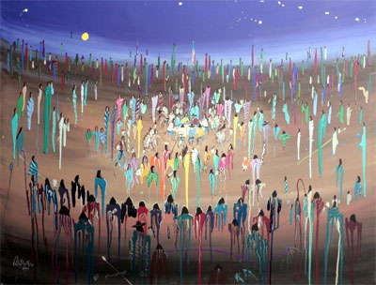
Quote by Indigenous Speaker at 1967 Conference on Native Education (Saskatoon)
“I pray that God will put the right words into our mouths. For the destinies of our beautiful brown babies rest partly in our ability to say the right words at the right time. It is an overwhelming responsibility, for, in only two days, we must break the fossilized crusts that have formed over us in the past 100 years of silence.”
Notes:
http://www.indianarttulsa.com/graphics/mcmurtry.jpg
Source of quote: National Conference on Indian and Northern Education Saskatoon, 1967, ed. Mrs. Mary Anne LaVallee

Slide 43
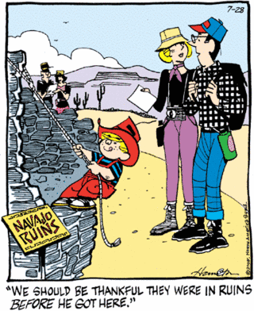
Negative Depiction of a Mass-murdered People in a Children’s Comic
Notes:
http://www.bluecorncomics.com/pics/dennis.gif

Slide 44
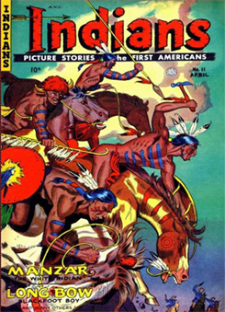
The Myth of the Bloodthirsty Savage
“The images are often those of murderous savages with painted faces, yelling war whoops, and descending on the unsuspecting women and children. Portrayals such as these, often motivated by social and political factors, were used to justify the inhuman treatment of Native people and the taking of their lands.”
Source: Images that Injure: Pictorial Stereotypes in the Media, editors Paul Martin Lester and Susan Dente Ross, 114.

Slide 45
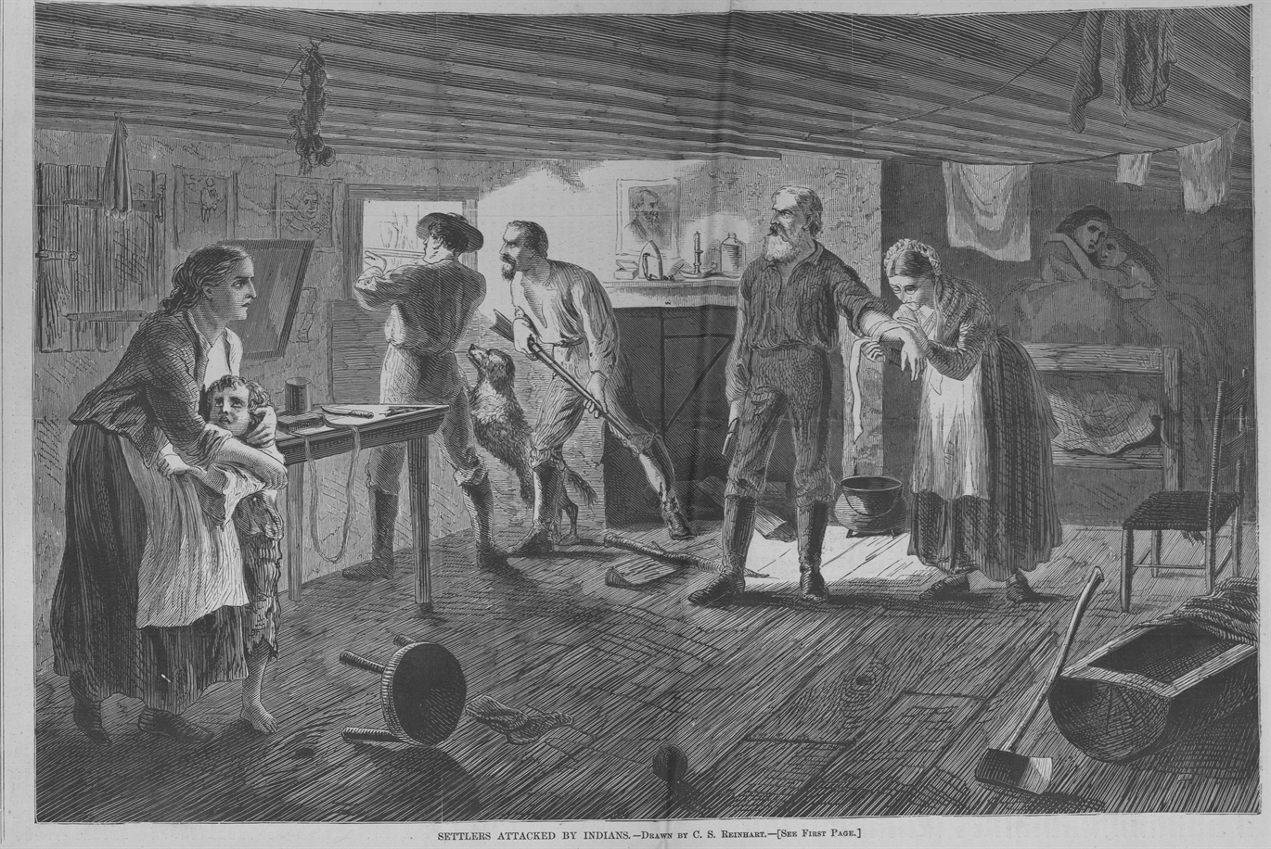
IMAGE TO GENERATE FEAR, AND COMPLICITY OF THE PUBLIC:
“SETTLERS ATTACKED BY INDIANS”
Source: Harper’s Weekly, circa 1870
Notes:
SOURCE: http://www.texasbeyondhistory.net/forts/images/attack-lg.jpg

Slide 46
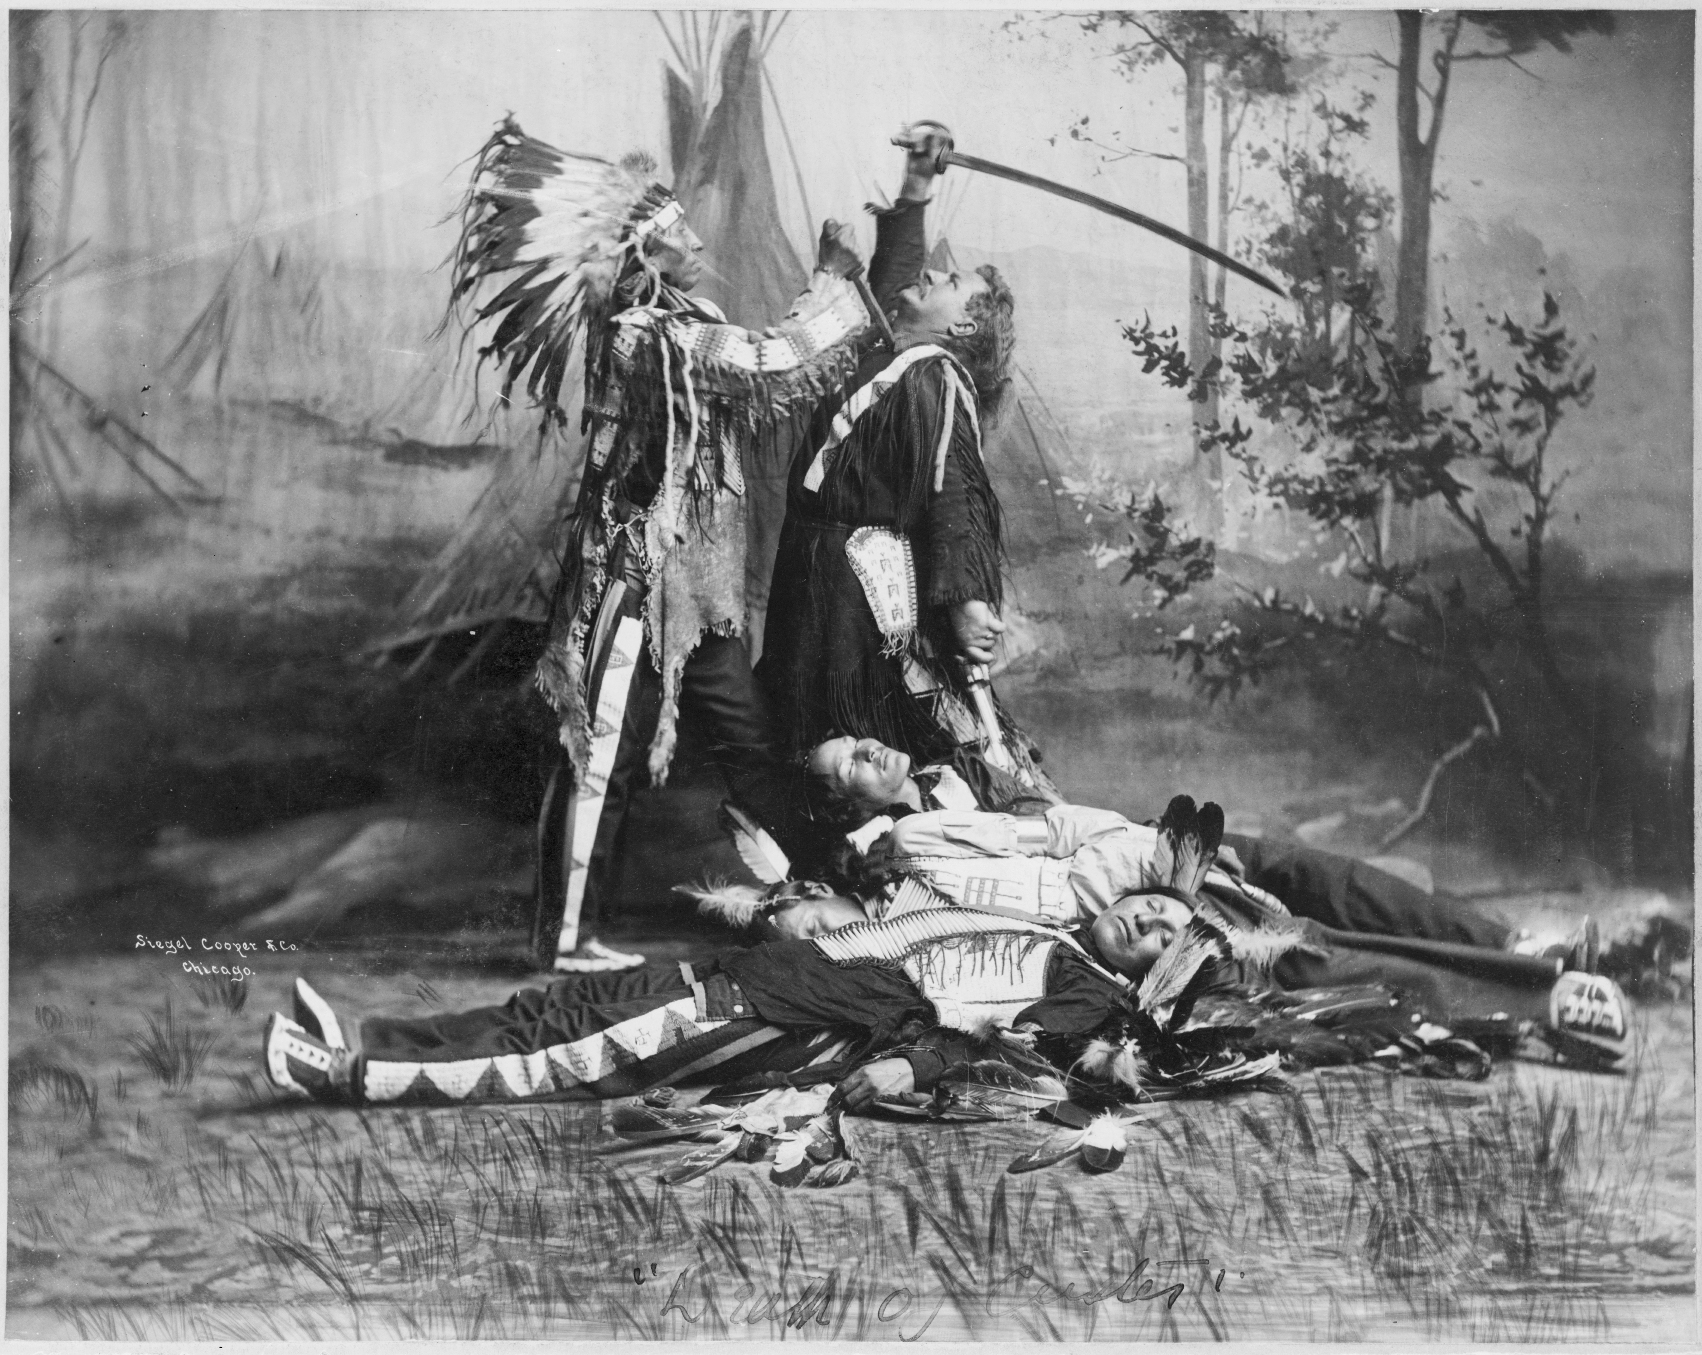
Pawnee Bill Wild West Show
Notes:
http://upload.wikimedia.org/wikipedia/commons/d/d6/Pawnee_bill_wild_west_show_c1905.jpg

Slide 47
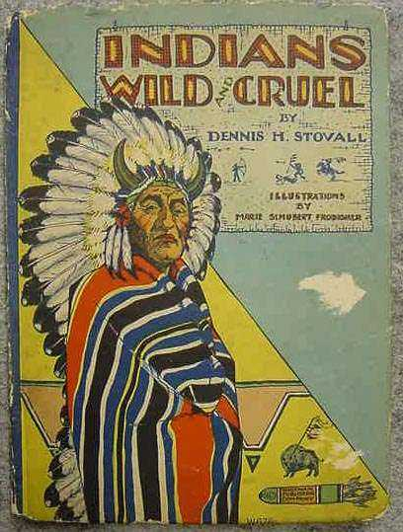
Notes:
http://www.aigenom.com/images/NAbook_Indians_Wild_and_Cruel_1928.jpg Paul Martin Lester and Susan Dente Ross state in their book, Images that Injure” “Since the first accounts in 1706 of the “skulking Indian enemy” (Copeland, 1993), the media have played a major role in fostering fear, hatred, and misunderstanding of Native Americans and inciting public opinion against them. Newspapers often fanned the flames of racial hatred by embellishing and sensationalizing the news of Indian attacks, in order to sell papers. But it wasn’t just the newspapers that perpetuated this myth. Movies, comic books, cartoons, literature, music and textbooks all played a role in what some have termed symbolic annihilation. Propagated myths include the delusion that America’s history began in 1492, that there is only one Native American culture, that American Indian peoples and cultures are becoming extinct, and that they are not part of contemporary society.”
Source: Images that Injure: Pictorial Stereotypes in the Media, editors Paul Martin Lester and Susan Dente Ross, p. 113

Slide 48
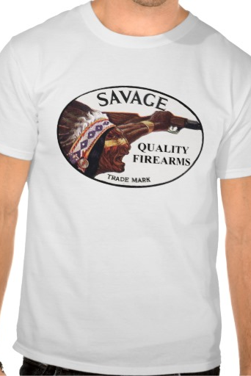
Savage Quality Firearms: The Dehumanization Continues
A clear instance of cultural appropriation of the MYTHICAL and CONSTRUCTED identity of the “savage indian.” In this instance, the “savage indian” is being used to sell death: guns and other equipment associated with killing. This is a current day example of the dehumanization and racialization of indigenous peoples.
Notes:
http://www.zazzle.com/savage_arms_screaming_indian_front_tshirt-235562313545920765

Slide 49
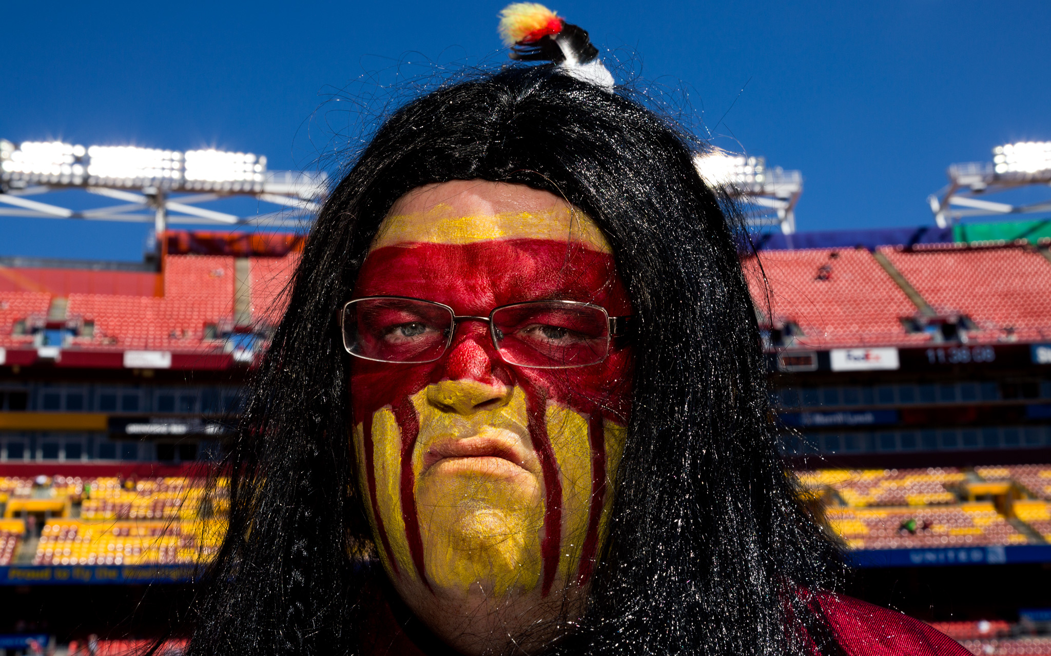
Branding the Savage Warrior
“The Redskins, a term defined as derogatory by Webster’s dictionary and viewed by many Native people with the same disgust as the word nigger, don’t just defeat a team, they scalp them, an image that brings with it another violent stereotype. Scalping is a term often accompanied by Indian and presents the image of fierceness, savagery, and violence. Most people don’t know it was Europeans who originated this practice in America. In the 1700s, Massachusetts offered bounties for the scalps of Indian people – 40 pounds for a male, 20 for a female or young child (Rethinking Schools, 1991).”
Source: Images that Injure: Pictorial Stereotypes in the Media, editors Paul Martin Lester and Susan Dente Ross, p. 115
A Washington ‘Redskins’ Fan. http://a1.espncdn.com/photo/2012/1005/mag_dc_fans_13.jpg
Notes:
Chief Wahoo, Mascot of the Cleveland Indians
http://indiancountrytodaymedianetwork.com/article/american-indians-mark-20th-year-of-protesting-cleveland-indians-mascot-chief-wahoo-106090

Slide 50
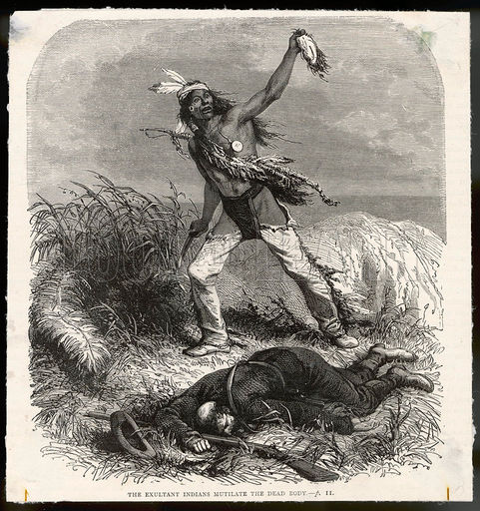
Notes:
Scalping was a European innovation. Beginning in the 1700s, bounty hunters would receive a certain amount of money for every Indian man, woman and child killed so long as they provided their victims scalps as proof. Despite this truism, the media has constantly attributed the practice of scalping to that of ‘savage’ Indians. By publishing such false information, the stereotype of the Savage Indian was able to survive, and justified genocidal policies of Canada’s indigenous population. It justified Duncan Campbell Scott’s policy of “killing the Indian within the Indian,” especially with regard to indigenous children within Indian Residential Schools. At these schools, cultural genocide was the critical element meant to ultimately destroy Indigenous identity in Canada. The children were punished when speaking their own languages, punished for missing their families, punished for showing any indigenous cultural affiliation, punished for wanted to be treated respectably as they had been at home.

Slide 51
Make no mistake: Canada is guilty of all 5 means of eliminationism, of genocide

Slide 52
IGNORANCE IS DEADLY ESPECIALLY WHEN COUPLED WITH WHITE, EUROCENTRIC POLICIES SUPPORTED BY MEDIA (including SILENCE), IN COMPLICITY WITH PUBLIC CONSENT OR APATHY
“Colonialism is genocidal euro-supremacism. It is the imposition of domineering White supremacist Western control.”
(Arnold Itwaru, “Master Race, Murder and Gory Globalization”, p. 36)

Slide 53
The Overwhelming Silence of Historical Truths:
A Crime Against Humanity?
Notes:
Despite the fact that the Canadian government has known, and has been the principal party to, murder and abuse of Canada’s indigenous population it has ensured silence on the topic of Indian Residential Schools in history and social studies curriculum until 2013. And even then, although changes have been designed to these curricula, and were to be rolled out in 2013, schools have not been provided the funding or resources necessary to ensure that this generation of youth can begin to research and discover truths about the genocidal tendencies of the Canadian government. Such silence has been deadly for Canada’s indigenous population as the omission of historical truths have generated a far-reaching apathy toward indigenous issues in Canadian society. Instead, what the Canadian population ‘hears’ from the government and the media is that indigenous groups are self-absorbed troublemakers.

Slide 54
Inclusion of Canadian Indian Residential Schools in Curriculum
Continuing silence:
The topic of Indian Residential Schools in Canadian history and social studies curriculum has been a forbidden topic until 2013.
Now, in Ontario (for example), this topic has been approved for Grades 6-12 BUT schools are unable to roll out new the curriculum as the government has not provided funding for new texts/materials, teacher training, etc.
Notes:
“For much of our history, all Canadian children – Aboriginal and non-Aboriginal alike – were taught that Aboriginal people were inferior, savage, and uncivilized, and that Aboriginal languages, spiritual beliefs and ways of life were irrelevant. Aboriginal people were depicted as having been a dying race, saved from destruction by the intervention of HUMANTARIAN EUROPEANS…the system led non-Aboriginal people to believe they were inherently superior.” Passage from “They Came for the Children” (TRC, 2012): p. 3;

Slide 55
http://www.youtube.com/watch?v=hqPIh-267fg
Song and Video: Canadian Holocaust -Try Not to Cry
By REDMuslima
Notes:
TAKE A SHORT BREAK BEFORE MOVIE; LET PEOPLE LOOK AT HISTORICAL EXAMPLES.

Slide 56
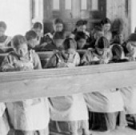
We Were Children
A Documentary Film by Tim Wolochatiuk (Director), and Jason Sherman (Writer)
http://www.nfb.ca/film/we_were_children/trailer/we_were_children_trailer
Notes:
DOWNLOAD MOVIE FROM NETFLIX.

